Slide 1
Lab 4: AMOVA, F-statistics, and Haplotype Networks
BIOL 4174/5174: Conservation Genetics Lab
2/14/2018

Slide 2
FIRST update class materials
Via GitHub:
cd ~/Desktop/<user>/ConsGen2018
git pull
Or via Blackboard:
Download lab2.tar.gz
Move to Desktop ConsGen2018 folder
tar –xvzf lab2.tar.gz

Slide 3
Today: First Analyses
Types of questions:
Is my genetic marker neutral?
How genetically different are my samples/ populations?
Is there structure/subdivision in my population(s)?
How are genetic variants related?

Slide 4
Defining terms…
Locus = location of a gene or other DNA sequence in a genome
Allele = variant form of a locus
Heterozygosity = proportion of diploid genotypes composed of two different alleles
Haplotype = group of genes or other loci inherited together from a single parent
Mitochondrial DNA = usually inherited uniparentally

Slide 5
Defining terms…
Haplotype diversity = measure of uniqueness of haplotypes
analogous to heterozygosity; calculated for haplotypes to provide a measure of diversity.
Ranges from 0 (no diversity) to 1 (very high diversity).
Nucleotide diversity (π) = average number of nucleotide differences per site between two individuals in a population
Theta (Θ) = Population mutation rate. If this number is the same or similar to π, then neutrality is assumed for the molecular marker in question. Tajima’s D provides a test of this hypothesis.

Slide 6
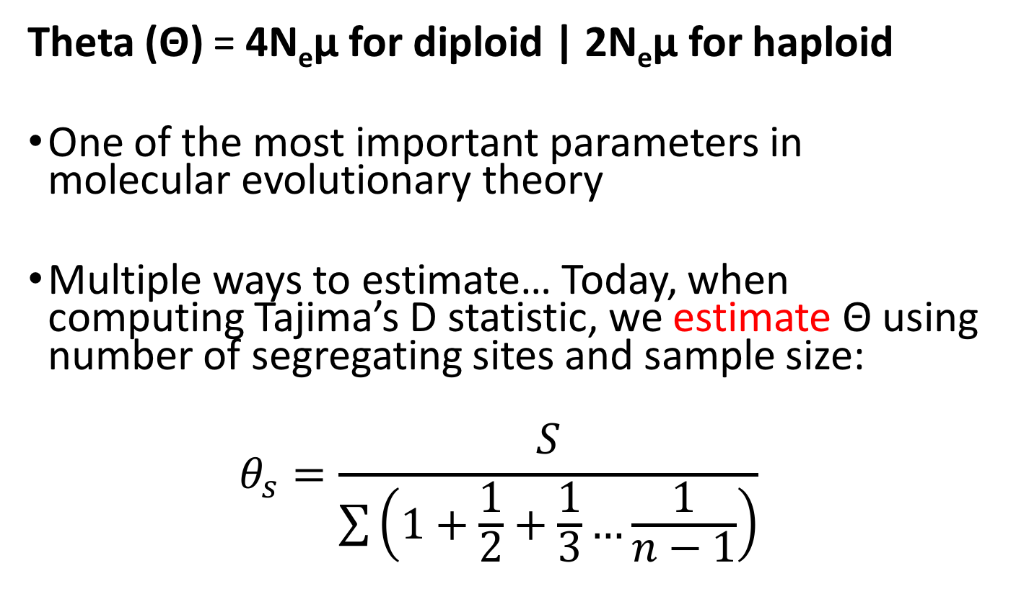
Note on theta…
Theta (Θ) = 4N_{e}µ for diploid | 2N_{e}µ for haploid
One of the most important parameters in molecular evolutionary theory
Multiple ways to estimate… Today, when computing Tajima’s D statistic, we estimate Θ using number of segregating sites and sample size:
$$θ_{s}=\frac{S}{\sum{\left(1+\frac{1}{2}+\frac{1}{3}…\frac{1}{n−1}\right)}}$$

Slide 7
Question 1: Is my genetic marker neutral?

Slide 8
Neutrality
“Neutral Genetic Markers”
Observed genetic variation has no effect on fitness
Useful for understanding random processes acting on population through time (e.g. genetic drift)
Most programs used for conservation genetics assume neutrality.
Why?? Neutral markers → Behave more predictably

Slide 9
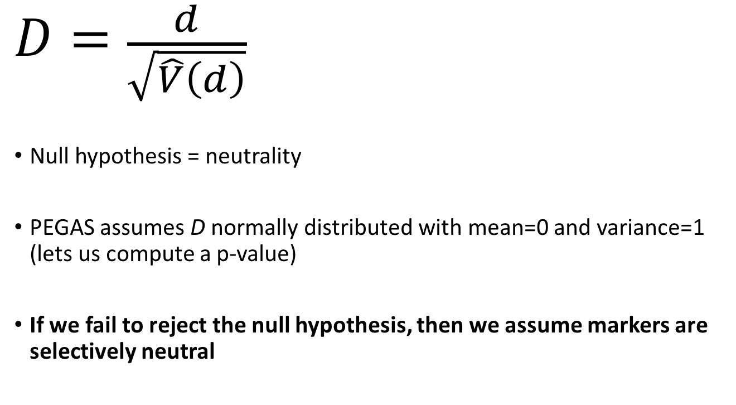
Testing for neutrality: Tajima’s D
Difference between π and Θ_{s}
$$D=\frac{d}{\sqrt{\hat{V}\left(d\right)}}$$
Null hypothesis = neutrality
PEGAS assumes D normally distributed with mean=0 and variance=1 (lets us compute a p-value)
If we fail to reject the null hypothesis, then we assume markers are selectively neutral
Standard deviation of d

Slide 10
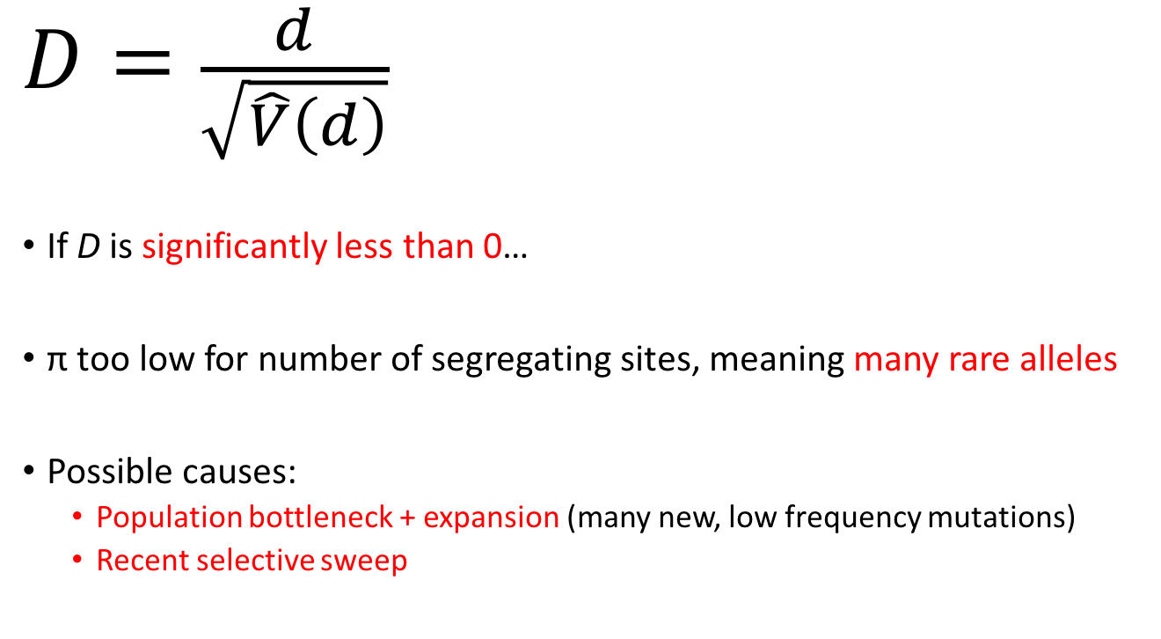
Tajima’s D
Difference between π and Θ_{s}
$$D=\frac{d}{\sqrt{\hat{V}\left(d\right)}}$$
If D is significantly less than 0…
π too low for number of segregating sites, meaning many rare alleles
Possible causes:
Population bottleneck + expansion (many new, low frequency mutations)
Recent selective sweep
Standard deviation of d

Slide 11
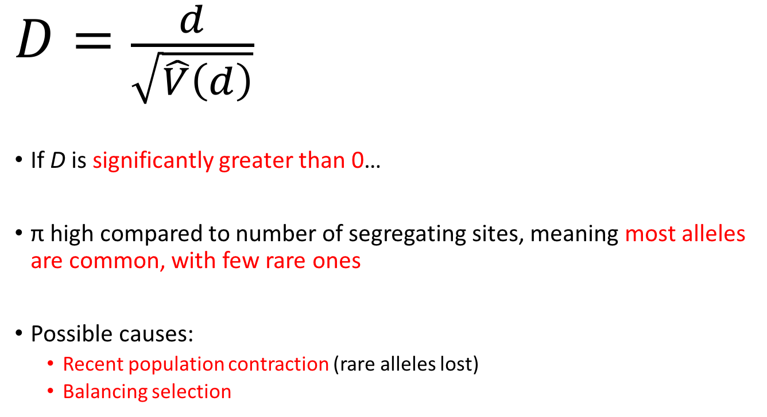
Tajima’s D
Difference between π and Θ_{s}
$$D=\frac{d}{\sqrt{\hat{V}\left(d\right)}}$$
If D is significantly greater than 0…
π high compared to number of segregating sites, meaning most alleles are common, with few rare ones
Possible causes:
Recent population contraction (rare alleles lost)
Balancing selection
Standard deviation of d

Slide 12
Tajima’s D and population demography

Slide 13
Question 2: How different are my samples/populations?

Slide 14
Fixation Indices (F-Statistics)
Used to describe levels of genetic variation within and among populations
F_{ST} = proportion of genetic variance contained in a subpopulation relative to the total
F_{IS} = proportion of genetic variance in individuals relative to their subpopulation
F_{IT} = proportion of genetic variance contained in individuals relative to total variance

Slide 15

Many definitions… Confusingly all referred to as F_{ST} in the literature…
Wright (1951)
$$F_{ST}=\frac{σ_{S}^{2}}{\overline{p}(1−\overline{p})}$$
Nei (1973)
$$G_{ST}=\frac{H_{T}−{\overline{H}}_{S}}{H_{T}}$$

Slide 16

Wright (1951)
$$F_{ST}=\frac{σ_{S}^{2}}{\overline{p}(1−\overline{p})}$$
Nei (1973)
$$G_{ST}=\frac{H_{T}−{\overline{H}}_{S}}{H_{T}}$$
Variance in allele frequancy
between populations
Mean frequency of allele p
Expected heterozygosity
of total population
Mean observed heterozygosity
of sub-populations
Account for multiple alleles by only considering total heterozygosity
Should be equivalent to F_{ST} in case of 2 alleles, and weighted average of F_{ST} when multiple alleles

Slide 17
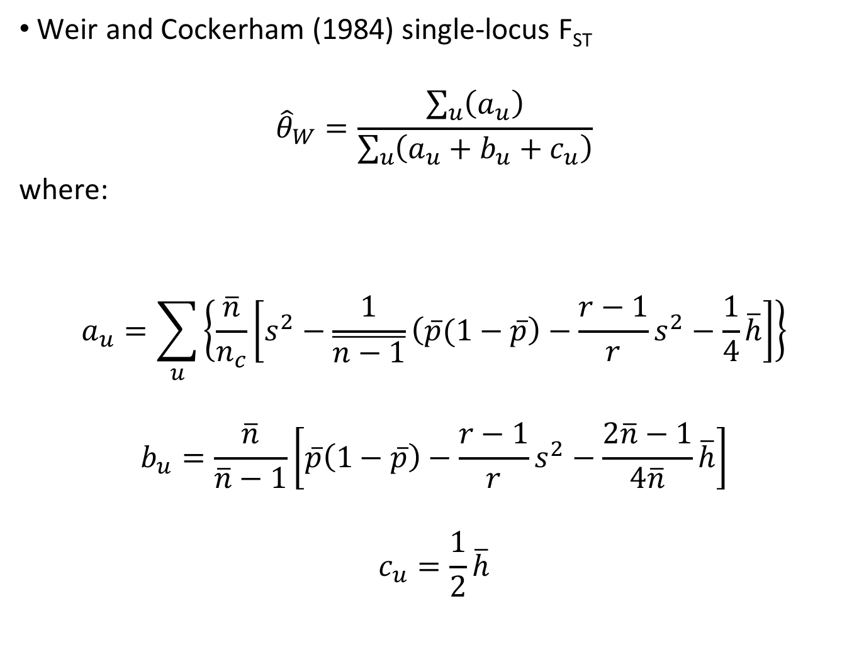
Weir and Cockerham (1984) single-locus F_{ST}
$${\hat{θ}}_{W}=\frac{\sum_{u}{\left(a_{u}\right)}}{\sum_{u}{\left(a_{u}+b_{u}+c_{u}\right)}}$$
where:
$$a_{u}=\sum_{u}{\left\{\frac{\overline{n}}{n_{c}}\left[s^{2}−\frac{1}{\overline{n−1}}\left(\overline{p}(1−\overline{p}\right)−\frac{r−1}{r}s^{2}−\frac{1}{4}\overline{h}\right]\right\}}$$
$$b_{u}=\frac{\overline{n}}{\overline{n}−1}\left[\overline{p}\left(1−\overline{p}\right)−\frac{r−1}{r}s^{2}−\frac{2\overline{n}−1}{4\overline{n}}\overline{h}\right]$$
$$c_{u}=\frac{1}{2}\overline{h}$$

Slide 18
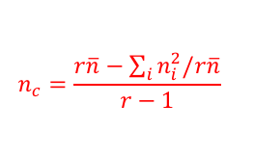
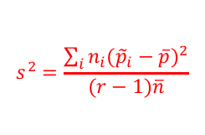
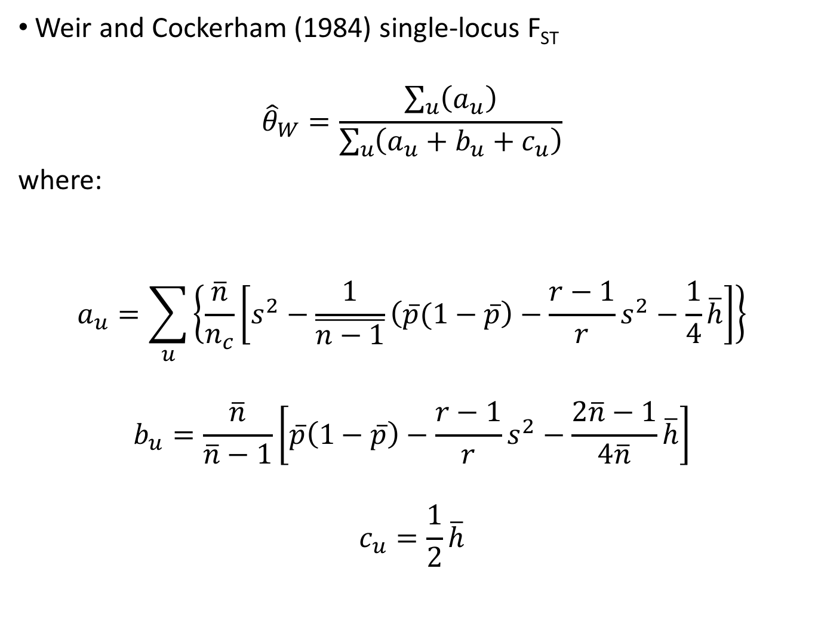
Weir and Cockerham (1984) single-locus F_{ST}
$${\hat{θ}}_{W}=\frac{\sum_{u}{\left(a_{u}\right)}}{\sum_{u}{\left(a_{u}+b_{u}+c_{u}\right)}}$$
where:
$$a_{u}=\sum_{u}{\left\{\frac{\overline{n}}{n_{c}}\left[s^{2}−\frac{1}{\overline{n−1}}\left(\overline{p}(1−\overline{p}\right)−\frac{r−1}{r}s^{2}−\frac{1}{4}\overline{h}\right]\right\}}$$
$$b_{u}=\frac{\overline{n}}{\overline{n}−1}\left[\overline{p}\left(1−\overline{p}\right)−\frac{r−1}{r}s^{2}−\frac{2\overline{n}−1}{4\overline{n}}\overline{h}\right]$$
$$c_{u}=\frac{1}{2}\overline{h}$$
For each allele “u”
Mean pop size
$$s^{2}=\frac{\sum_{i}{n_{i}{\left({\tilde{p}}_{i}−\overline{p}\right)}^{2}}}{(r−1)\overline{n}}$$
# of populations
$$n_{c}=\frac{r\overline{n}−\sum_{i}{n_{i}^{2}/r\overline{n}}}{r−1}$$
Average heterozygosity
of allele
Mean frequency of allele
The Point → Account for unequal sample sizes, and multiple alleles

Slide 19
F_{ST} Bias
Can be highly influenced by sampling, and depending on which F_{ST} estimator is used…
Used to measure subpopulation differentiation but also affected by anything which affects evolutionary rate of a locus (e.g. mutation rate)
F_{ST} ranges from 0 to 1
0 = no population differentiation
1 = very high differentiation
Negative values can be interpreted as 0 values
Or inappropriate groupings of samples

Slide 20
F_{ST}
Population A
Population B

Slide 21
Influence of Low Sample Size (Low F_{ST})
Population A
Population B

Slide 22
Influence of Low Sample Size (High F_{ST})
Population A
Population B

Slide 23
Influence of Low Sample Size (High F_{ST})
Population A
Population B

Slide 24
Question 3: Is there structure/subdivision within my population?

Slide 25
Population Structure
Which groups are interbreeding? →Important for conservation genetics and management
Are there groups with restricted gene flow?
Various methods
Statistical measures (e.g. F_{ST})
AMOVA (Analysis of Molecular Variance – Excoffier et al. 1992)
A priori assumptions of population structure
Bayesian clustering algorithms (e.g., Structure – Pritchard et al. 2000)
No a priori assumptions. Bayesian witchcraft

Slide 26
AMOVA
AMOVA (Analysis of Molecular Variance – Excoffier et al. 1992)
Testing A priori assumptions of population structure
Creates a distance matrix (genetic distance)
Partitions amount of variance in distance matrix explained by hierarchical variance components:
We will test significance using random permutation

Slide 27
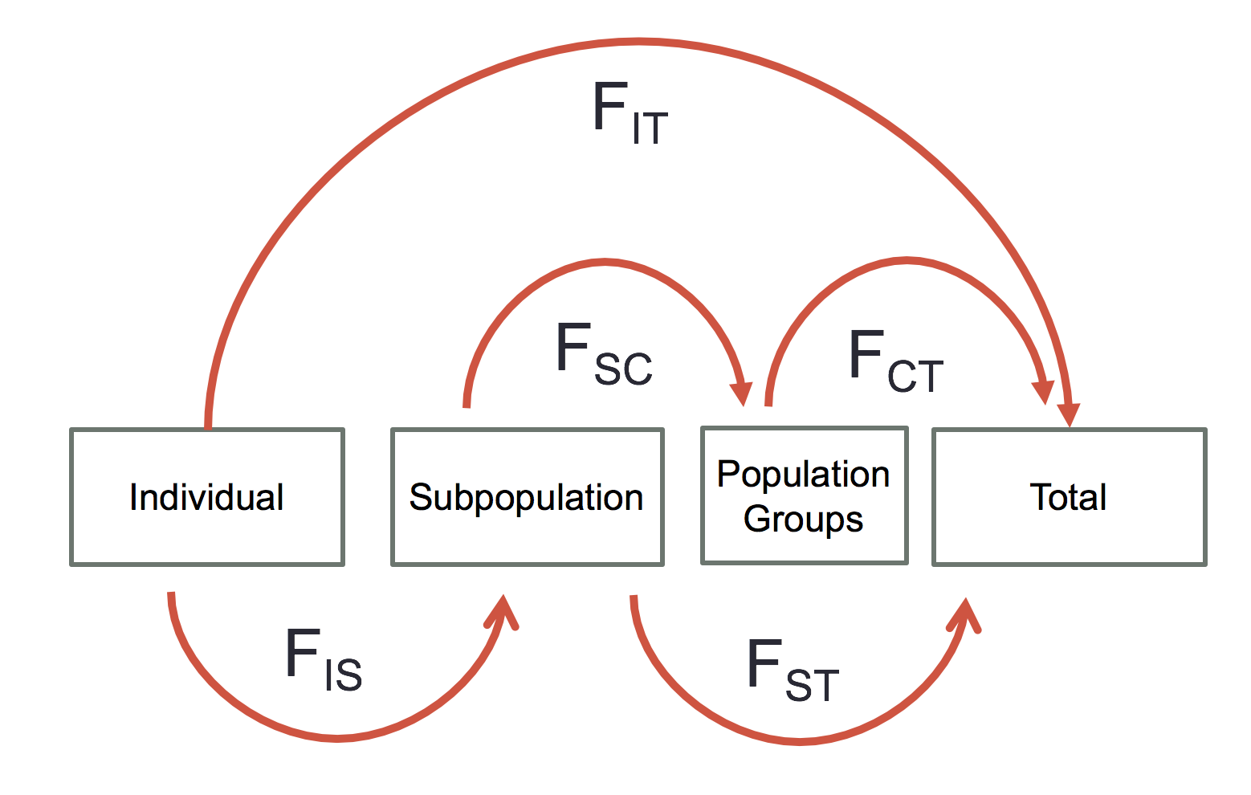

Slide 28
AMOVA
Examining genetic diversity at three levels
Among subpopulations (= F_{ST})
Among populations within groups
Among groups
Several R packages: ade4, pegas, poppr
Graphical: Arlequin 3.5 (Excoffier and Lischer 2010)

Slide 29
Permutation tests
Permutation Test - Allows for the null distribution to be obtained, and significance to be tested.
Reorder the data by randomly assigning individuals to new groups, populations, etc.
New distance matrix is made
Calculations are performed again
Repeat
Should do this several thousand times

Slide 30
Question 4: How are genetic variants related?

Slide 31
Haplotype Networks

Slide 32
Haplotype Networks
Open circles = observed haplotypes
Filled circles = unobserved, hypothetical intermediates
Ticks on edges = number of differences (mutations)

Slide 33
Haplotype Networks
Many methods to construct…
Minimum Spanning Network
Find shortest raw distances
Median Joining Network
Modifies Minimum Spanning Network with ancestral reconstructions to find most parsimonious solution

Slide 34
Many more methods, which we won’t use…
Statistical Parsimony (TCS Method)
Ancestral Maximum Parsimony
Integer Neighbor-Joining Network
Tight Walk Spanner
Average Dissimilarity

Slide 35
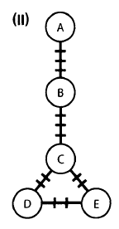
Minimum Spanning Network
Does not reconstruct hypothetical ancestors
Tick marks in the network to the right represent the number of bases that vary between observed nodes.
Goal: Find network where all haplotypes are connected with minimal total differences (mutations) in network
Weakness: Most parsimonious solution may involve unobserved haplotypes

Slide 36
Median Joining Network
Starts with a minimum spanning tree
Reconstructs hypothetical haplotypes in order to improve parsimony
“Steiner” nodes → Unobserved nodes connecting to three or more observed ones
Can perform better than Minimum Spanning Tree

Slide 37
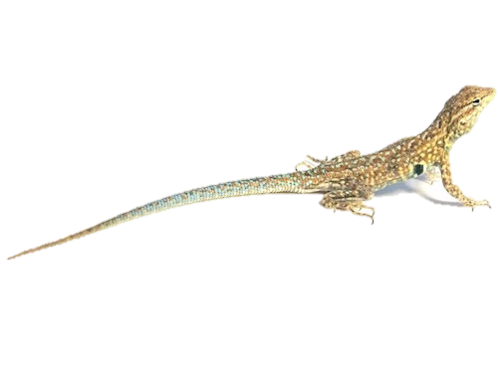
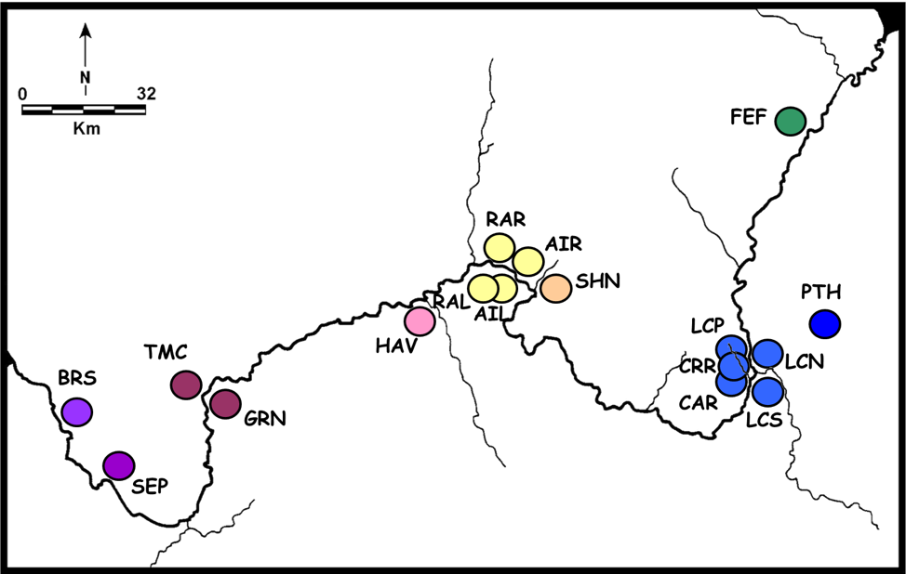
Today’s Dataset
Mitochondrial genes: ATPase 8 and ATPase 6
Small lizard
Grand Canyon

Slide 38
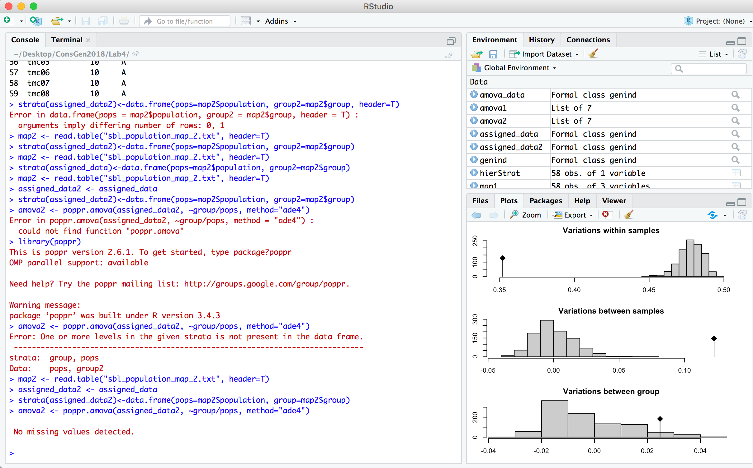
R: Statistical computing language
Interact via terminal (like bash, sort of)
Good luck

